Slide 1
UNIT-1
Internet Security

Slide 2
Table of Content
Overview Of Network Security
Network Security Services
Attacks
Security Issues In TCP/IP Suit
Sniffing
Spoofing
ARP Poisoning
ICMP Exploits
IP Address Spoofing
IP Fragment Attacks

Slide 3
Overview of Network Security
Network security is the practice of protecting computer networks from various threats and ensuring the confidentiality, integrity, and availability of data and resources.
It involves a combination of technologies, policies, and practices designed to safeguard network infrastructure and data from unauthorized access, misuse, modification, or destruction.

Slide 4

CIA
CIA Traid

Slide 5
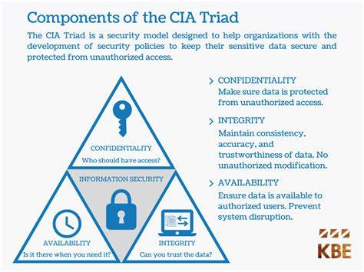
CIA Traid (Fundamental Concepts)
Confidentiality: Ensures that data is accessible only to authorized users.
Integrity: Protects data from being altered or tampered with by unauthorized users.
Availability: Ensures that network services and resources are available to authorized users when needed.

Slide 6
Difference Cyber Security vs. Computer Security
Cyber security and computer security are related fields but they focus on different aspects of protecting information and systems.
Cyber Security | Computer Security
Scope: Broader than computer security, encompassing the protection of internet-connected systems, including hardware, software, and data, from cyber attacks. | Scope: More focused on the protection of individual computers and devices, ensuring the safety and integrity of the data they store and process.
Focus: Primarily on protecting networks, applications, and data from unauthorized access, attacks, and damage. This includes measures against hacking, phishing, malware, ransomware, and other cyber threats. | Focus: Ensuring the confidentiality, integrity, and availability of data within a specific computer system. This includes protecting against unauthorized access, viruses, and other forms of malware.
Components: Network security, application security, information security, operational security, end-user education, and disaster recovery/business continuity planning. | Components: Antivirus software, firewalls, encryption, access controls, and security patches for operating systems and applications.

Slide 7
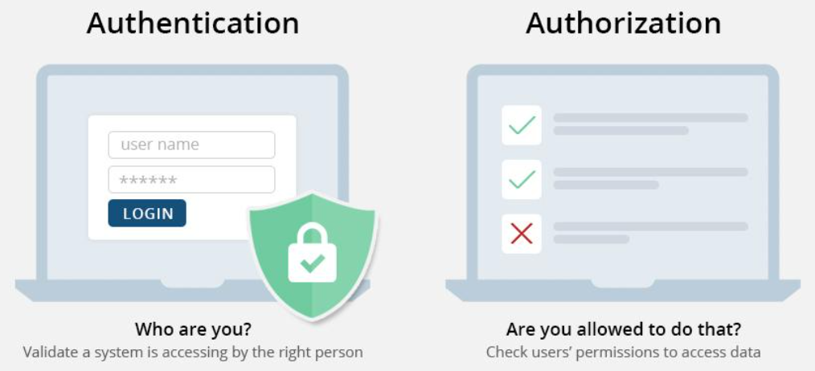
Authorization and Authentication
Security Services
Authorization and authentication are two crucial concepts in security, often used together but serving different purposes.
Authentication is about verifying identity, while authorization is about granting permissions based on that verified identity.

Slide 8
Authorization vs. Authentication cont….
 | Authentication | Authorization
Purpose | To verify the identity of a user or system. | To determine what an authenticated user or system is allowed to do.
Process | Determines if the user or system is who they claim to be. | Grants or denies permissions based on the user's identity and roles.
Methods | Passwords Biometrics (fingerprints, facial recognition) Multi-factor authentication (combining two or more methods, like a password and a code sent to a phone) Security tokens | Access control lists (ACLs) Role-based access control (RBAC) Policy-based access control
Example | Logging into a website with a username and password. | Once logged into a website, accessing certain pages or performing certain actions (like viewing, editing, or deleting content) based on user roles (admin, editor, viewer).

Slide 9
Active vs. Passive Attack
Active and passive attacks are two types of security breaches that differ in their methods and impacts on systems and data.
Active attacks involve direct interference with systems to cause harm or gain control, while passive attacks focus on stealthily gathering information without altering the systems or data.

Slide 10
Active vs. Passive Attack cont..
 | Active Attack | Passive Attack
Nature | Involves direct interaction with the target system to alter its state or disrupt its normal operations. | Involves eavesdropping or monitoring communications and data without altering them.
Goal | To modify, delete, or inject data, disrupt services, or gain unauthorized access to resources. | To gather information, such as sensitive data or communications, without detection.
Examples | Man-in-the-middle (MITM) attack: Intercepting and altering communications between two parties. Denial of Service (DoS) attack: Overloading a system to make it unavailable. SQL injection: Inserting malicious SQL commands to manipulate a database. Malware deployment: Introducing viruses, worms, or trojans to compromise systems. | Eavesdropping: Listening to private communications over a network. Traffic analysis: Monitoring the flow of data to infer information. Passive wiretapping: Intercepting data traveling over networks without altering it.
Impact | Often immediate and noticeable, causing disruption, data loss, or system damage. | Often undetectable by the target, as the system and data remain unaltered, but can lead to significant security breaches if sensitive information is obtained.

Slide 11
Common Threats
Malware: Malicious software such as viruses, worms, trojans, and spyware designed to damage or disrupt systems.
Social engineering: Manipulation technique that exploits human psychology to gain access to confidential information, networks, or physical locations.
Denial of Service (DoS) Attacks: Attempts to make a network service unavailable by overwhelming it with traffic.
Man-in-the-Middle (MitM) Attacks: Interception and possible alteration of communication between two parties without their knowledge.
SQL Injection: Exploiting vulnerabilities in an application's software by injecting malicious SQL commands.

Slide 12
Attacks
Network security attacks come in various forms, targeting different aspects of networks and systems.
Denial of Service (DoS) Attack | Dictionary Attack
Distributed Denial of Service (DDoS) Attack | Credential Stuffing
Man-in-the-Middle (MitM) Attack | Zero-Day Attack
Phishing Attack | Eavesdropping Attack
Malware Attack | IP Spoofing
SQL Injection Attack | DNS Spoofing
Cross-Site Scripting (XSS) Attack | Session Hijacking
Brute Force Attack | Insider Threat &
Advanced Persistent Threat (APT) | Social Engineering Attacks

Slide 13
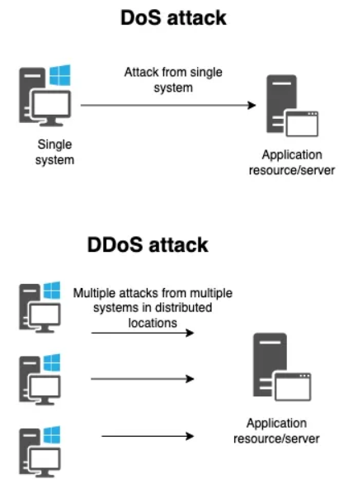
Denial of Service (DoS) and Distributed Denial of Service (DDoS) Attacks
DoS Attack: An attacker overwhelms a system, service, or network with excessive traffic, causing it to become unavailable to legitimate users.
DDoS Attack: Similar to a DoS attack but launched from multiple compromised systems simultaneously, making it harder to defend against.

Slide 14
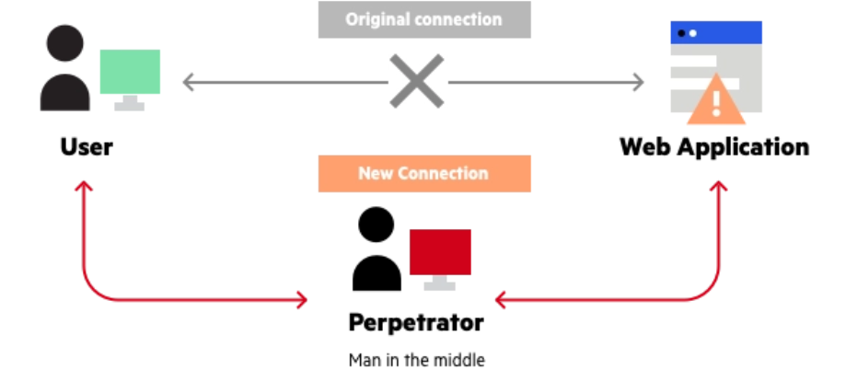
Man-in-the-Middle (MitM) Attacks
Definition: An attacker intercepts and possibly alters the communication between two parties without their knowledge.
Example: Eavesdropping on a communication session to steal sensitive information such as login credentials.

Slide 15
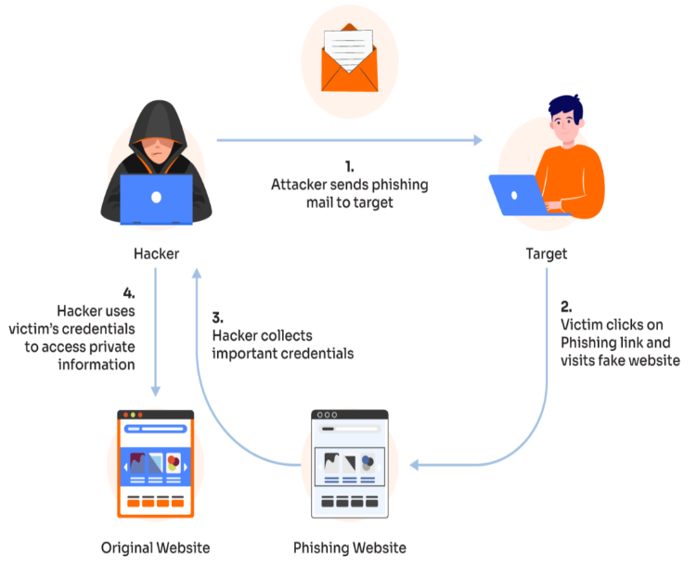
Phishing Attacks
Definition: An attacker uses deceptive emails, messages, or websites to trick individuals into providing sensitive information such as usernames, passwords, or credit card numbers.
Example: A fake email that appears to be from a legitimate organization asking the recipient to click on a link and enter their login details.

Slide 16
Malware Attacks
Definition: Malicious software designed to damage, disrupt, or gain unauthorized access to a computer system.
Types:
Viruses: Attach themselves to legitimate programs and spread when the infected programs are executed.
Worms: Self-replicating malware that spreads without user intervention.
Trojans: Disguised as legitimate software but perform malicious actions once executed.
Ransomware: Encrypts the victim's data and demands a ransom for its decryption.
Spyware: Software that secretly monitors and collects information about a user's activities without their consent.

Slide 17
Malware Attacks
Definition: Malicious software designed to damage, disrupt, or gain unauthorized access to a computer system.
Types:
Adware: Software that automatically displays or downloads advertisements, often bundled with free programs.
Keylogger: Malicious software that records every keystroke made on a computer to steal sensitive information like passwords.
Botnets: Networks of compromised computers remotely controlled by attackers to perform malicious activities, often without the user's knowledge.
Rootkit: Malicious software that hides itself deep in your computer to secretly control it without you knowing.
Backdoor: A secret way for hackers to sneak into your computer without needing a password.

Slide 18
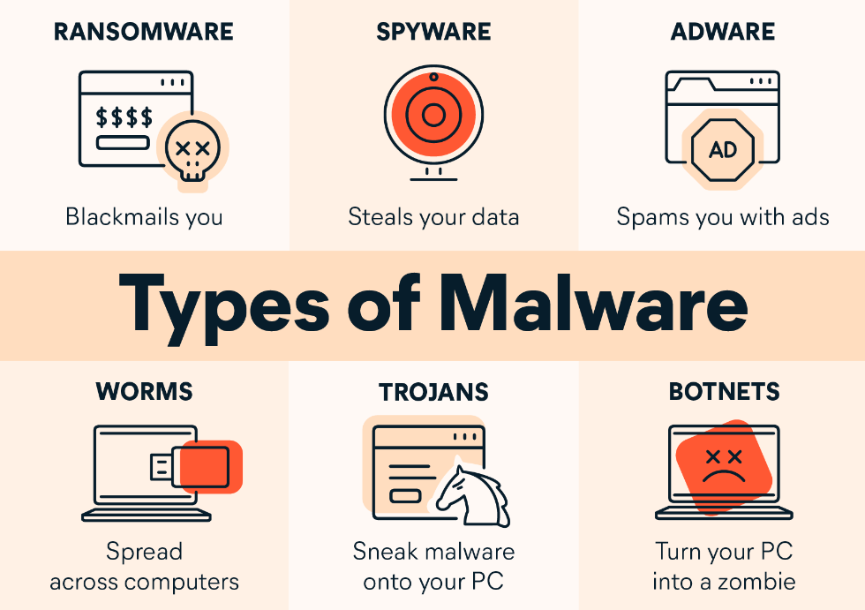
Malware Attacks

Slide 19
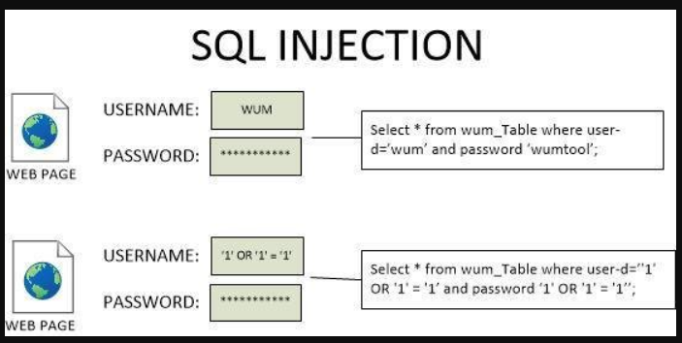
SQL Injection Attacks
Definition: An attacker inserts malicious SQL code into a web application's input fields to manipulate the backend database and gain unauthorized access to data.
Example: Retrieving or modifying sensitive data from a database by exploiting vulnerabilities in the application's input validation.

Slide 20
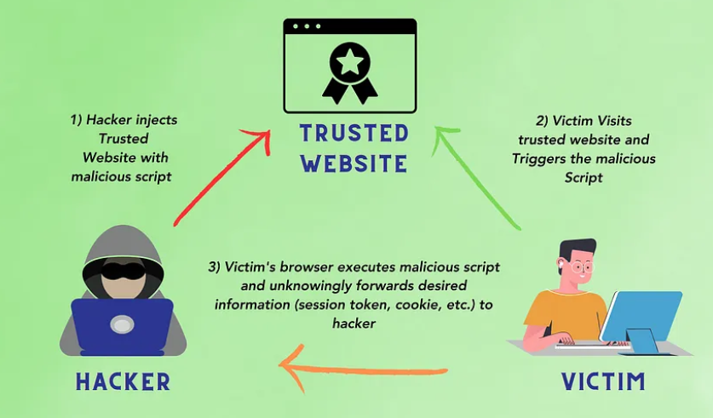
Cross-Site Scripting (XSS) Attacks
Definition: An attacker injects malicious scripts into webpages viewed by other users, which then execute in the users' browsers and can steal information or perform actions on their behalf.
- Stored XSS: The malicious script is permanently stored on the target server.
- Reflected XSS: The malicious script is reflected off a web server, typically via a search or error message.

Slide 21
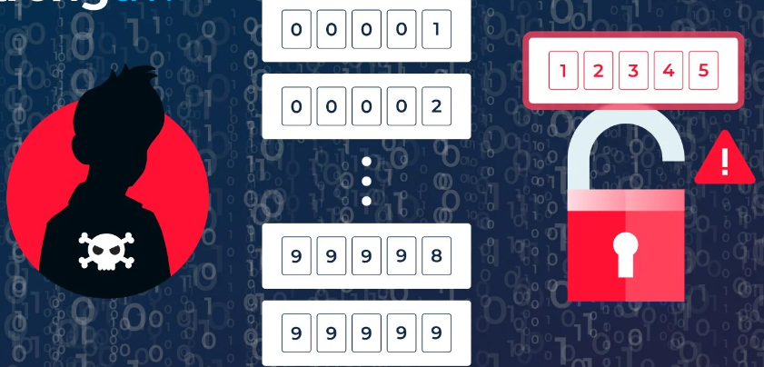
Brute Force Attacks
Definition: An attacker systematically tries all possible combinations of passwords or encryption keys until the correct one is found.
Example: Attempting to log into a user's account by trying different password combinations until the correct one is guessed.

Slide 22
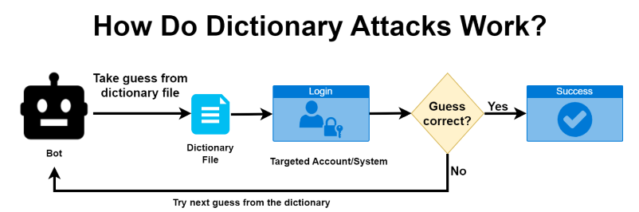
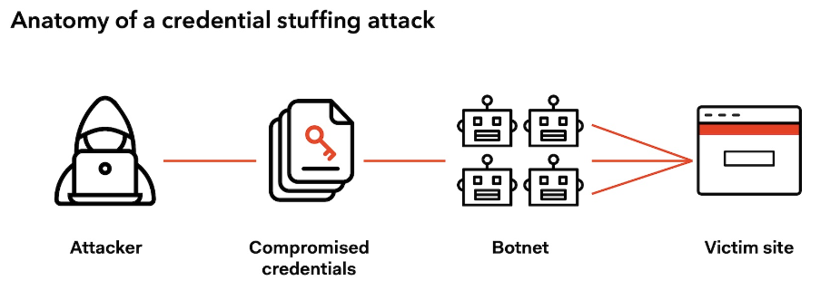
Password Attacks
- Dictionary Attack: Using a predefined list of commonly used passwords to attempt to gain access.
- Credential Stuffing: Using stolen username and password combinations from one breach to try and gain access to other accounts where the same credentials might be used.

Slide 23
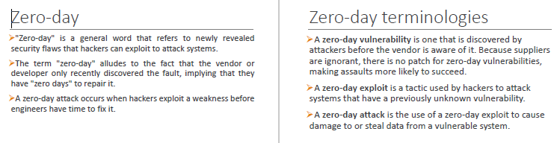
Zero-Day Attacks
Definition: An attack that exploits a previously unknown vulnerability in software or hardware, for which there is no current fix.
Example: Exploiting a new vulnerability in a popular application before the developer has had a chance to patch it.

Slide 24
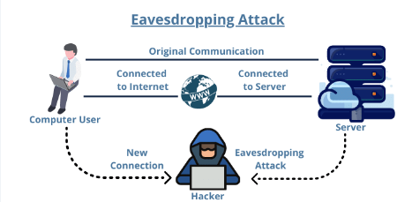
Eavesdropping Attacks
Definition: An attacker secretly listens to private communications over a network.
Example: Intercepting unencrypted communications over a public Wi-Fi network to steal sensitive information.

Slide 25
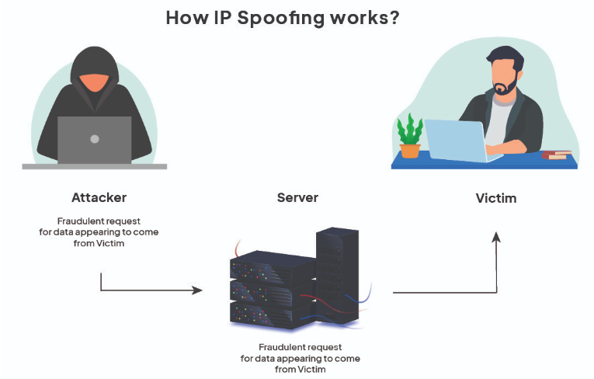
Spoofing Attacks
- IP Spoofing: An attacker sends packets from a false IP address to impersonate another device.
- DNS Spoofing: An attacker alters DNS records to redirect traffic from legitimate websites to malicious ones.

Slide 26
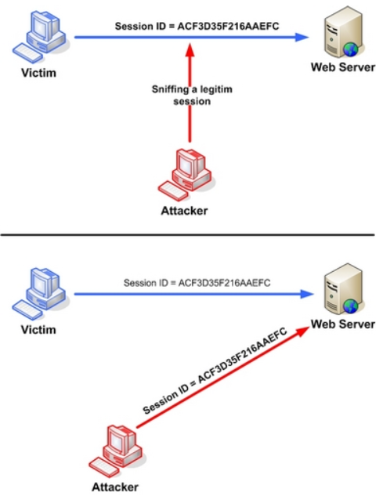
Session Hijacking
Definition: An attacker takes control of a user's session by stealing or predicting the session token.
Example: Gaining unauthorized access to a user's online account by hijacking their session after they have logged in.

Slide 27
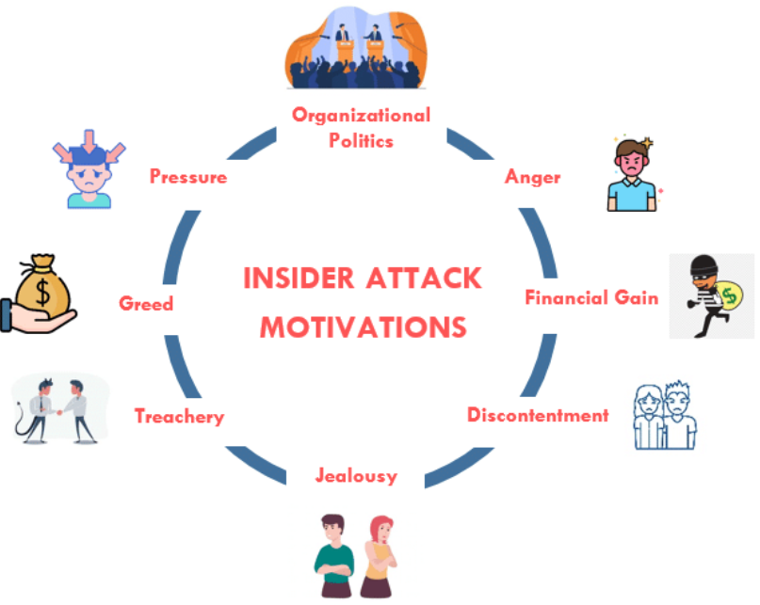
Insider Threats
Definition: Attacks that originate from within the organization by employees, contractors, or other insiders who have legitimate access to the network.
Example: A disgruntled employee stealing sensitive data or sabotaging systems.

Slide 28
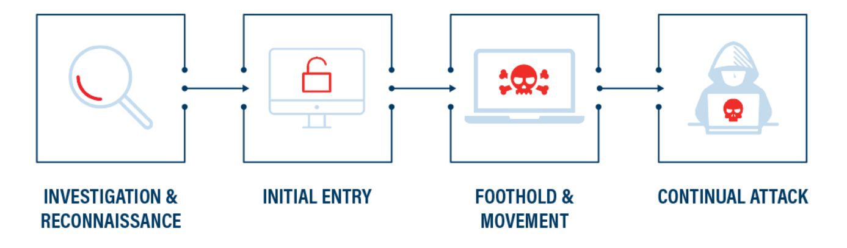
Advanced Persistent Threats (APTs)
Definition: Prolonged and targeted cyberattacks in which an intruder gains access to a network and remains undetected for an extended period.
Example: State-sponsored hacking groups infiltrating government or corporate networks to steal sensitive information over a long period.

Slide 29
Social Engineering Attacks
Social engineering is a manipulation technique that exploits human psychology to gain access to confidential information, networks, or physical locations. It often involves tricking individuals into breaking normal security procedures. Social engineering attacks rely on human error rather than vulnerabilities in software or systems. Here are some common methods of social engineering:
Phishing | Spear Phishing
Baiting | Pretexting
Quid Pro Quo | Tailgating / Piggybacking
Vishing / Voice Phishing

Slide 30
Social Engineering Attacks cont…
Phishing: Attackers send fraudulent emails or messages that appear to be from reputable sources to trick individuals into revealing personal information, such as passwords or credit card numbers.
Spear Phishing: A more targeted form of phishing where attackers tailor their messages to a specific individual or organization, often using information gathered from social media or other sources.
Baiting: Attackers leave physical devices, like USB drives, in conspicuous locations. When someone finds and uses the device, malware is installed on their system.
Water Holing: Attacker acts like a crocodile in a grassland that silently waits in the water hole for the prey to come near water hole and lean.

Slide 31
Social Engineering Attacks cont…
Pretexting: Attackers create a fabricated scenario to obtain information from a target. For example, they might impersonate a co-worker or authority figure to gain trust and extract sensitive information.
Quid Pro Quo: Attackers offer something desirable, such as free software or services, in exchange for information or access.
Tailgating (or Piggybacking): Attackers follow authorized personnel into restricted areas without proper credentials, often by simply asking someone to hold the door open.
Vishing (Voice Phishing): Attackers use phone calls to impersonate legitimate entities, like banks or tech support, to extract confidential information from targets.

Slide 32
Defense Against Social Engineering
Education and Training: Regularly train employees to recognize and respond to social engineering attempts. Awareness is the first line of defense.
Verification: Encourage verifying the identity of individuals requesting sensitive information or access, especially if the request is unexpected or unusual.
Policies and Procedures: Implement and enforce strict policies regarding the handling of sensitive information and access to secure areas.

Slide 33
Defense Against Social Engineering
Multi-Factor Authentication (MFA): Use MFA to add an extra layer of security, making it harder for attackers to gain access even if they obtain login credentials.
Regular Audits: Conduct regular security audits to identify potential vulnerabilities and improve security measures.
Social engineering preys on human nature, making it one of the most challenging threats to defend against. However, by fostering a culture of security awareness and implementing strong policies, organizations can significantly reduce the risk of falling victim to these types of attacks.

Slide 34
Basics of Network
What is a network?
A network is a collection of computers and devices interconnected by communication channels that allow them to share resources and information.
Networks can range from a small home network to a large corporate network or even the global internet.

Slide 35
Types of Networks:
Local Area Network (LAN): Covers a small geographic area, like a home or office. Typically, it’s used to connect computers and devices within a single location.
Wide Area Network (WAN): Covers a broad area, such as a city, country, or even global connections. The internet is the largest example of a WAN.
Metropolitan Area Network (MAN): Spans a city or a large campus, larger than a LAN but smaller than a WAN.
Personal Area Network (PAN): Used for connecting devices in a very small area, like a few meters around a person. Bluetooth is an example.

Slide 36
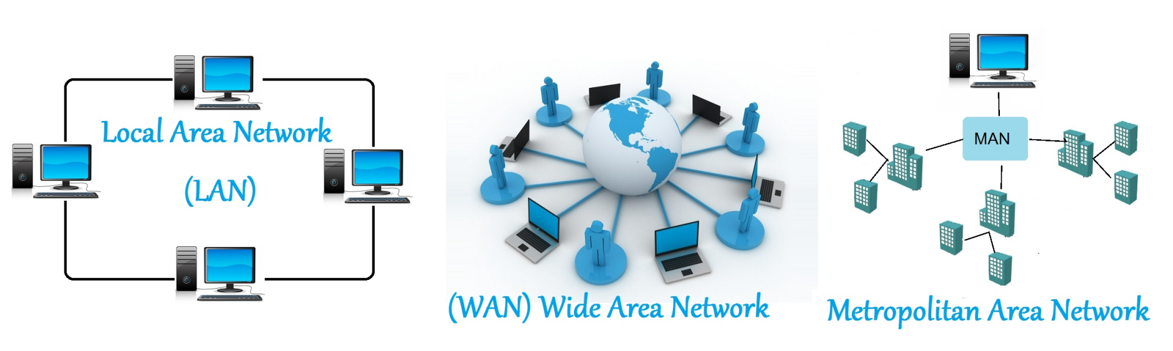

Slide 37
Network Devices
Network devices are hardware components that facilitate communication, data transmission, and resource sharing between devices on a network.

Slide 38
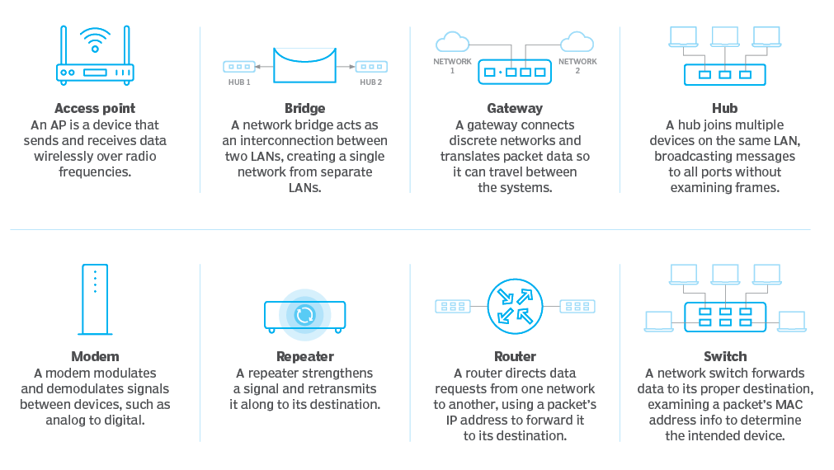

Slide 39
Network Topology
Network topology refers to the arrangement of different elements like nodes, links, and devices in a computer network. It defines how these components are connected and interact with each other.
Common types include point to point, bus, star, ring, mesh, and tree topologies, each with its own advantages and disadvantages.

Slide 40
Network Topology cont….
Point-to-point Topology is a type of topology that works on the functionality of the sender and receiver. It is the simplest communication between two nodes, in which one is the sender and the other one is the receiver.
Bus Topology is a network type in which every computer and network device is connected to a single cable. It is bi-directional.

Slide 41
Network Topology cont….
Ring Topology, it forms a ring connecting devices with exactly two neighboring devices
Star Topology, all the devices are connected to a single hub through a cable. This hub is the central node and all other nodes are connected to the central node.

Slide 42
Network Topology cont….
Tree Topology, this topology is the variation of the Star topology. This topology has a hierarchical flow of data.
Mesh Topology, every device is connected to another device via a particular channel.
Hybrid Topology, this topological technology is the combination of all the various types of topologies we have studied above. Hybrid Topology is used when the nodes are free to take any form.

Slide 43
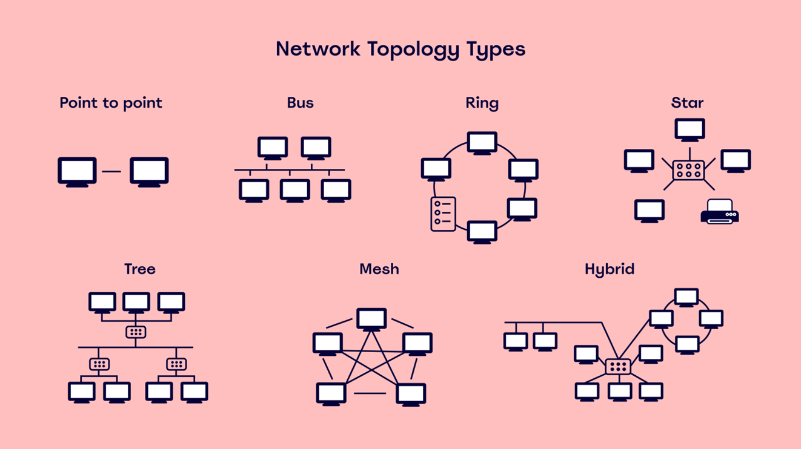

Slide 44
IP Addressing
Each device on a network has a unique identifier known as an IP address. It allows devices to locate and communicate with each other.
IPv4: Uses a 32-bit address format (e.g., 192.168.1.1).
IPv6: Uses a 128-bit address format, offering a larger address space (e.g., 2001:0db8:85a3:0000:0000:8a2e:0370:7334).

Slide 45
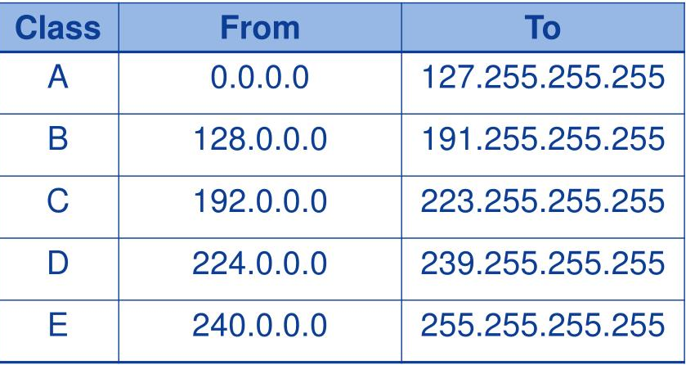

Slide 46
OSI Model
OSI stands for Open Systems Interconnection, where open stands to say non-proprietary.
It is a 7-layer architecture with each layer having specific functionality to perform.
All these 7 layers work collaboratively to transmit the data from one person to another across the globe. The OSI reference model was developed by ISO – ‘International Organization for Standardization‘, in the year 1984.
The OSI model provides a theoretical foundation for understanding network communication.

Slide 47
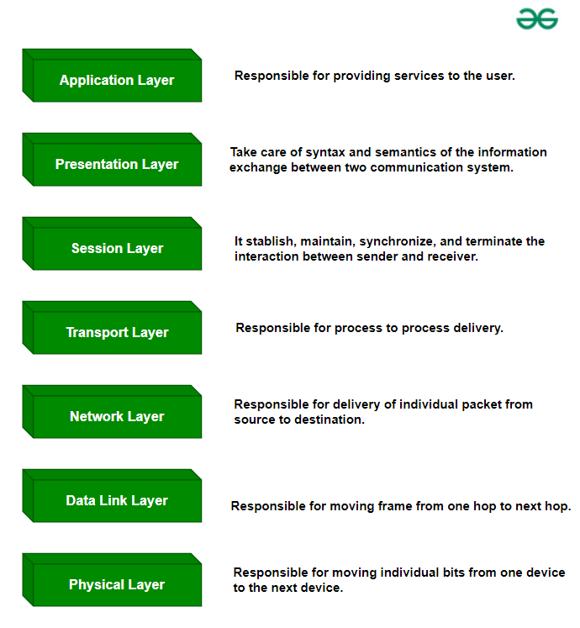

Slide 48
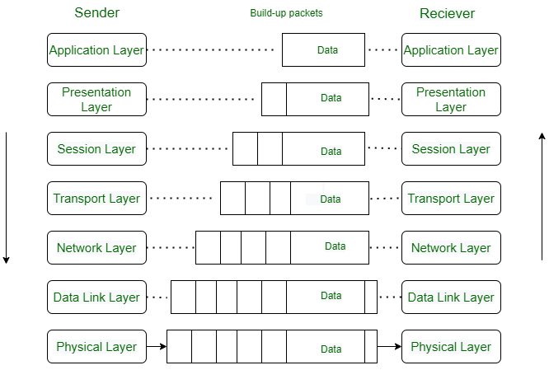
Data flows through the OSI model
Application Layer: Applications create the data.
Presentation Layer: Data is formatted and encrypted.
Session Layer: Connections are established and managed.
Transport Layer: Data is broken into segments for reliable delivery.
Network Layer: Segments are packaged into packets and routed.
Data Link Layer: Packets are framed and sent to the next device.
Physical Layer: Frames are converted into bits and transmitted physically.

Slide 49
Protocols
Protocols and standards are important in computer networks.
They are like the rules and guidelines that allow different devices and systems to communicate and work together smoothly.
Protocols define how data is sent, received, and processed, while standards ensure that various technologies are compatible with each other.

Slide 50
TCP & IP
TCP (Transmission Control Protocol) is one of the main protocols of the TCP/IP suite.
Transmission Control Protocol (TCP) ensures reliable and efficient data transmission over the internet.
Transmission Control Protocol (TCP) is a connection-oriented protocol for communications that helps in the exchange of messages between different devices over a network.
Internet Protocol (IP) is a method that is useful for sending data from one device to another from all over the internet. It is a set of rules governing how data is sent and received over the internet.

Slide 51
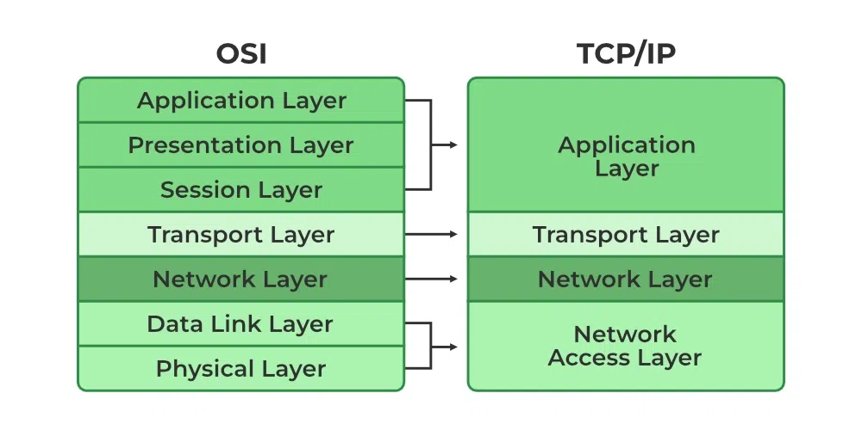
TCP/IP
The TCP/IP model is a fundamental framework for computer networking.
It stands for Transmission Control Protocol/Internet Protocol, which are the core protocols of the Internet.
This model defines how data is transmitted over networks, ensuring reliable communication between devices. It consists of four layers:
the Application Layer.
the Transport Layer,
the Network /Internet Layer,
the Link Layer,

Slide 52
Application Layer
Purpose: This is the layer where end-user applications and protocols operate. It’s responsible for providing network services directly to applications.
Protocols:
HTTP/HTTPS (Hypertext Transfer Protocol/Secure): Used for web browsing.
FTP (File Transfer Protocol): Used for transferring files.
SMTP (Simple Mail Transfer Protocol): Used for email transmission.
DNS (Domain Name System): Translates domain names into IP addresses.

Slide 53
Transport Layer
Purpose: Manages end-to-end communication between devices, providing error recovery and flow control.
Protocols:
TCP (Transmission Control Protocol): Provides reliable, connection-oriented communication. It ensures that data packets are delivered in the correct order and without errors.
UDP (User Datagram Protocol): Provides a connectionless, less reliable communication service. It’s used where speed is more critical than reliability, such as streaming.

Slide 54
Internet Layer
Purpose: Handles the logical addressing and routing of data packets across different networks.
Protocols:
IP (Internet Protocol): Responsible for addressing and routing packets to ensure they reach the correct destination.
IPv4: Uses 32-bit addresses.
IPv6: Uses 128-bit addresses, providing a larger address space.
ICMP (Internet Control Message Protocol): Used for network diagnostics and error reporting (e.g., ping).

Slide 55
Link Layer
Purpose: Manages physical network hardware and the data link protocols. It’s responsible for the actual transmission of data over the physical network.
Protocols:
Ethernet: Commonly used in local area networks (LANs).
Wi-Fi: Wireless networking protocol.
PPP (Point-to-Point Protocol): Used for direct connections between two nodes.

Slide 56
Security Issues In TCP/IP Suit
Sniffing
Spoofing
ARP Poisoning
ICMP Exploits
IP Address Spoofing
IP Fragment Attack

Slide 57
Sniffing
“Sniffing" specifically refers to the process of capturing and analyzing network traffic. This technique is used to monitor data packets as they travel across a network.
Network Traffic Capture:
Purpose: To capture data packets transmitted over a network to understand, monitor, or diagnose network traffic. It can be used by attackers to steal sensitive data.
Data Packets: Each packet contains headers and data. Headers include information like source and destination IP addresses, ports, and protocol information. The data contains the actual data being transmitted.

Slide 58
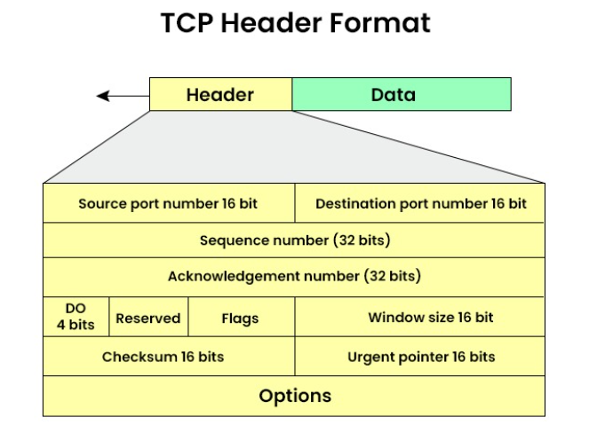
Packet structure

Slide 59
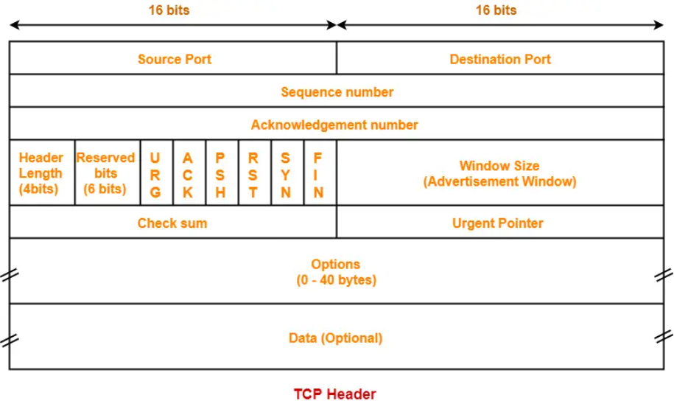
TCP Header

Slide 60
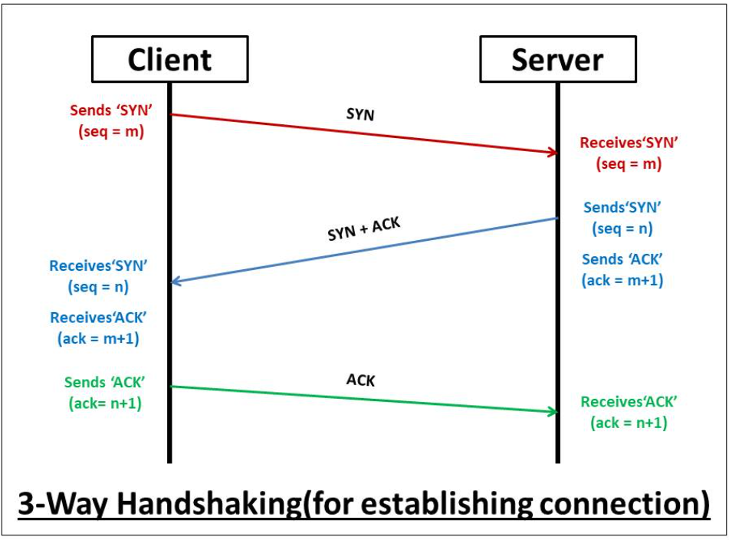
TCP 3-way handshake

Slide 61
Spoofing
Email Spoofing(Example)
Definition: Forging the sender’s email address to make it appear as though the email comes from a legitimate source.
Purpose:
Phishing: Deceiving recipients into revealing sensitive information.
Spam and Fraud: Distributing malicious content or fraudulent offers.
Spoofing attacks exploit weaknesses in network protocols and security mechanisms to deceive and gain unauthorized access or disrupt normal operations.

Slide 62
Spoofing
Spoofing refers to various techniques where an attacker disguises themselves as a trusted entity to deceive users or systems. Spoofing can compromise network security and integrity, leading to unauthorized access, data breaches, or other malicious activities.
IP Spoofing
Definition: An attacker falsifies the source IP address in packet headers to make the packets appear as though they originate from a trusted source.
Purpose:
Bypassing Security Controls: By masquerading as a legitimate user or system, the attacker may bypass IP-based access controls or filters.
Denial of Service (DoS): In a DoS attack, the attacker can flood a target with packets that appear to come from a trusted source, overwhelming the system.

Slide 63
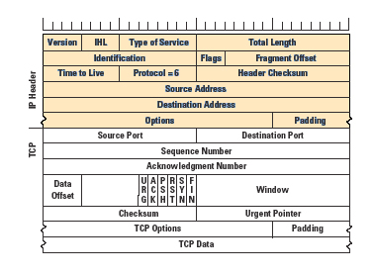
TCP/IP Header

Slide 64
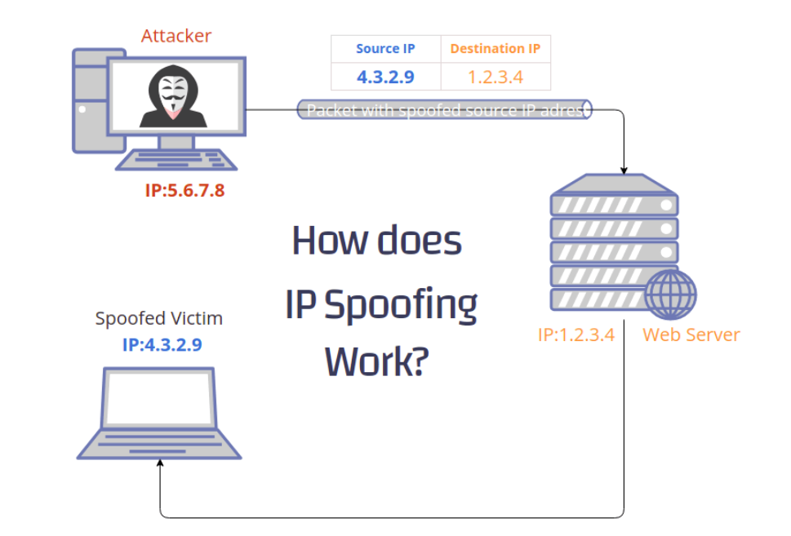
IP Address Spoofing

Slide 65
ARP Poisoning
ARP Poisoning (also known as ARP Spoofing or ARP Cache Poisoning) is a type of attack on a local network that targets the Address Resolution Protocol (ARP), which is used to map IP addresses to MAC addresses within a local network segment.
By exploiting ARP’s lack of authentication, an attacker can deceive devices into sending data to the wrong destination, leading to various potential security issues.

Slide 66
ARP Basics:
ARP operates within a local network (Layer 2 of the OSI model) to resolve IP addresses into MAC addresses.
When a device wants to communicate with another device on the same network, it broadcasts an ARP request asking, "Who has IP address X.X.X.X? Tell me your MAC address."
The device with that IP address responds with an ARP reply containing its MAC address.

Slide 67
ARP Attack
Spoofed ARP Replies: The attacker sends forged ARP replies to the network, associating their own MAC address with the IP address of a legitimate device (e.g., the default gateway or another important network device).
Cache Poisoning: These fake ARP replies are cached by the devices on the network, leading them to update their ARP tables with incorrect information. As a result, packets intended for the legitimate device are now sent to the attacker’s device instead.

Slide 68
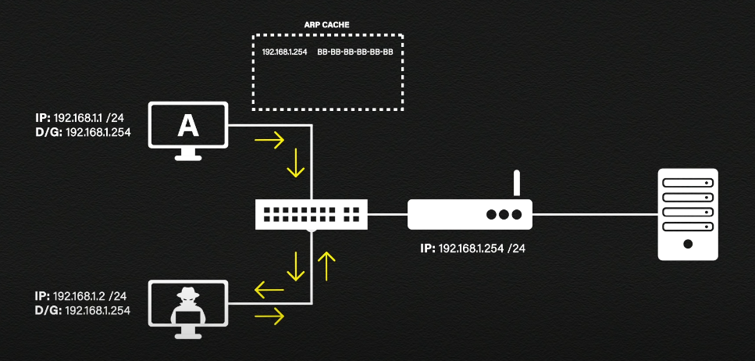
ARP Attack

Slide 69
Consequences of ARP attack
Man-in-the-Middle (MitM) Attacks: The attacker can intercept, modify, or inject packets between the two communicating devices, potentially eavesdropping on or tampering with sensitive data.
Session Hijacking: By capturing session cookies or credentials, the attacker can impersonate users or gain unauthorized access.
Denial of Service (DoS): By redirecting traffic or overwhelming a device with malicious data, the attacker can disrupt network services.

Slide 70
Example Scenario
Attacker's Actions:
The attacker sends ARP replies claiming that their MAC address corresponds to the IP address of the network's default gateway.
Devices on the network update their ARP tables with this incorrect information, sending their traffic intended for the gateway to the attacker’s device instead.
Result:
The attacker can now intercept, monitor, or modify the traffic. They can redirect it to malicious sites, steal sensitive information, or inject harmful data.

Slide 71
ICMP Exploits
ICMP Exploits refer to various security vulnerabilities and attacks that exploit the Internet Control Message Protocol (ICMP).
ICMP is a fundamental network protocol used for sending error messages and operational information about network conditions.
However, its design and functionality also make it susceptible to certain types of attacks.

Slide 72
Common ICMP Exploits
ICMP Flood Attack
An attacker floods a target with a high volume of ICMP Echo Request (ping) packets, overwhelming the target’s network resources.
Impact: This can lead to a Denial of Service (DoS) where legitimate users are unable to access network services due to the saturation of network bandwidth or system resources.
Mitigation:
Rate Limiting: Implement rate limiting on ICMP traffic to prevent excessive requests.
Firewalls and Filters: Configure firewalls to restrict ICMP traffic or block excessive ICMP packets.

Slide 73
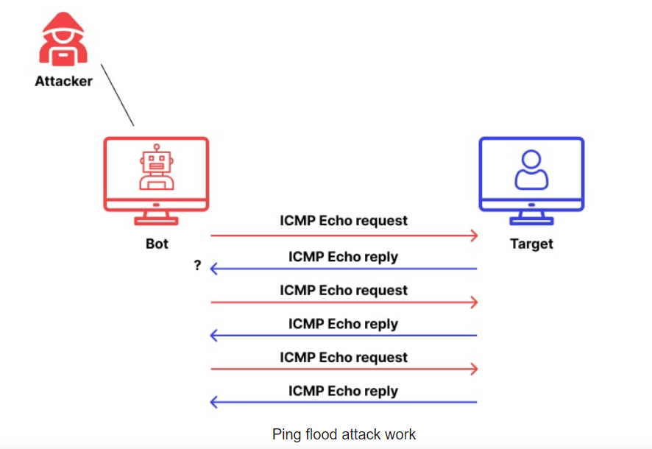
Common ICMP Exploits

Slide 74
Ping of Death
An attacker sends malformed or oversized ICMP Echo Request packets (larger than the maximum allowed size) to the target.
These oversized packets can exploit vulnerabilities in the target system’s handling of IP fragmentation.
Impact: Can cause system crashes or reboots due to buffer overflow vulnerabilities.
Mitigation:
Packet Filtering: Implement filtering to block unusually large or malformed packets.

Slide 75
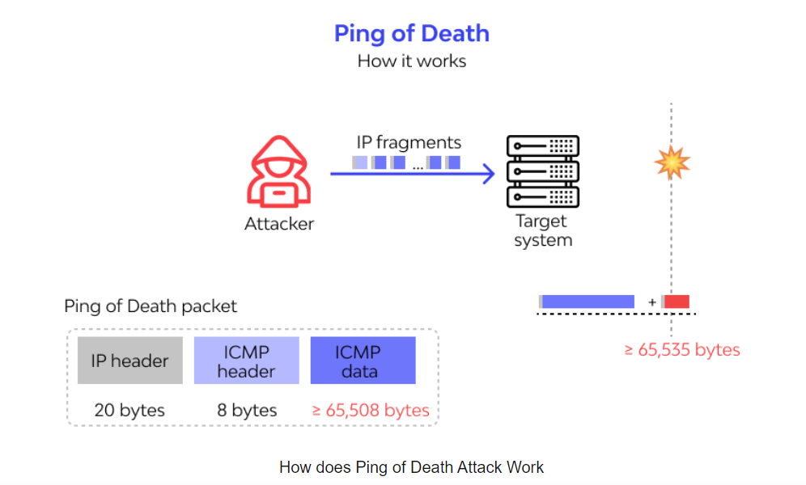
Ping of Death

Slide 76
Smurf Attack
The attacker sends ICMP Echo Requests (ping) to a broadcast address, which causes all devices on the network segment to respond.
The responses are then directed towards the intended victim, amplifying the traffic.
Impact: Similar to ICMP Flood, it leads to a DoS by overwhelming the victim with a large volume of ICMP Echo Replies.
Mitigation:
Disable IP Broadcast Responses: Configure network devices to prevent responding to ICMP requests sent to broadcast addresses.
Network Segmentation: Isolate networks to limit the scope of broadcast traffic.

Slide 77
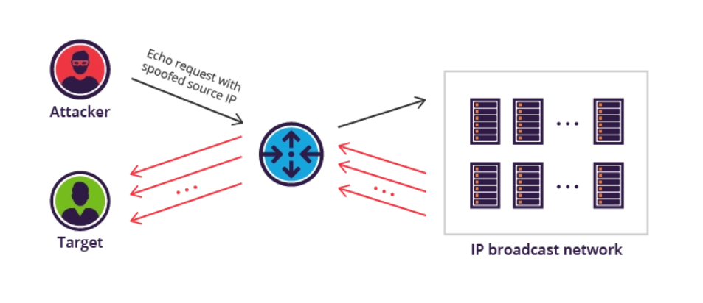
Smurf Attack

Slide 78
IP Fragment Attack
IP fragmentation occurs when an IP packet exceeds the Maximum Transmission Unit (MTU) size for a network path. Routers must split the large packet into smaller fragments to be transmitted.
IP fragmentation attacks is a type of cyber attack that exploits how IP packets are fragmented and reassembled to evade security controls and launch attacks.
Attackers manipulate fragmented packet parameters like offsets and sizes to trigger vulnerabilities or bypass firewall rules.
Uses a large fragment designed to crash systems attempting to allocate huge buffers during reassembly.
Sends invalid fragmentation flags triggering crashes in some Windows TCP/IP implementations.

Slide 79
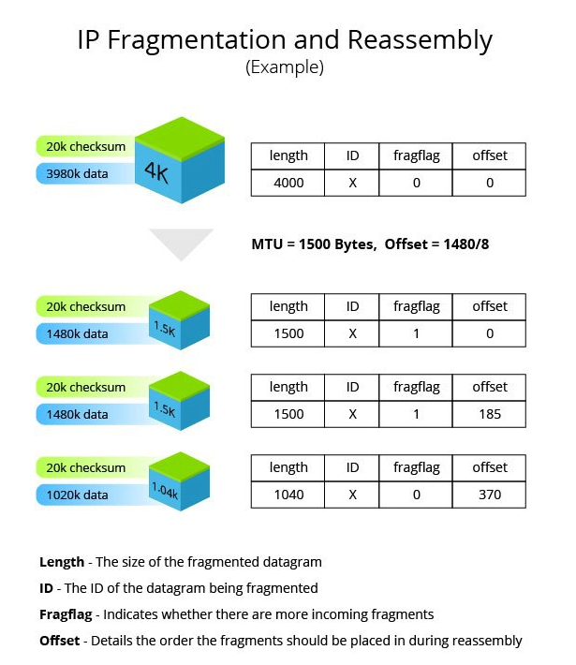
IP Fragment Attack

Slide 80
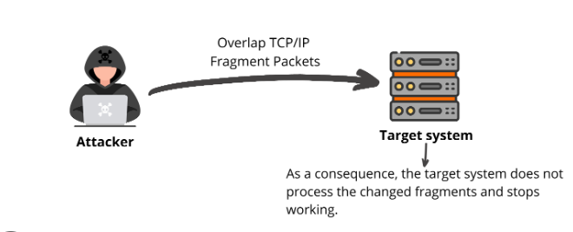
IP Fragmentation Attack

Slide 81

yrmhgys

